Slide 1
Convension case

Slide 2
Agenda
Case overview, scope and limitations
Implemented solution
Overview of solution
Infrastucture solution
Code
Questions

Slide 3
Case overview, scope and limitations
Scope of case
The overview of the overall solution
The aws infrastucture with focus on performance
The implementain of a the rest api with focus on xxxxx

Slide 4
Case overview, scope and limitations
Limitations:
The is cicd to handle
Automated testing
Building appliation code
Pushing artifacts to ECR in AWS.
Deployment of IoC
Frontend implementation in react
My main focus areas as developer is backend services (eventdriven microservices and rest api), databases, infrastucture, monitoring and cicd.
OpenId in details
I only worked with usage of open Id and microsoft AD integrations to AWS and usage in rest api. I have not worked in the openId server on a usage part, so from my point of view its ”just” a service that provides a ID Token from frontend service, that will be passed to every call to rest api, to validate if the user has access to that specific endpoint.

Slide 5
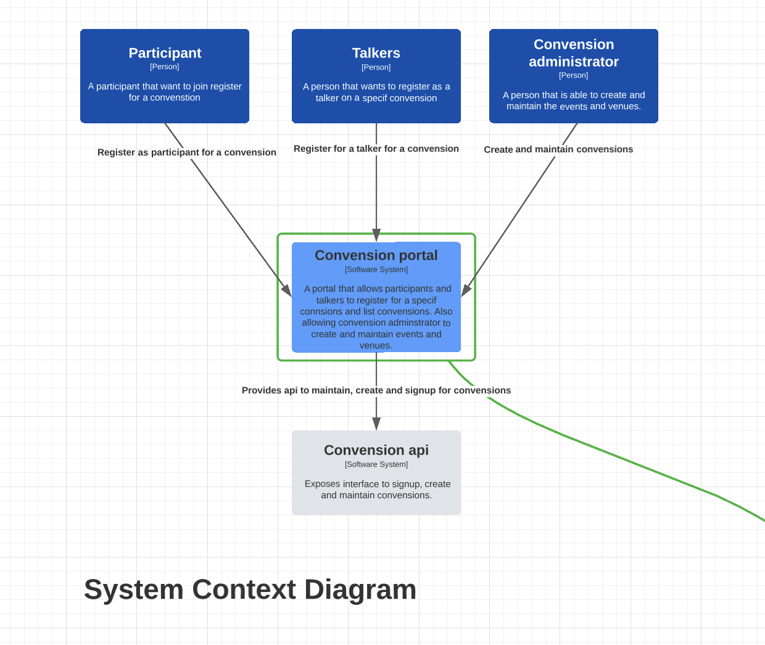
Overview of solution in c4

Slide 6
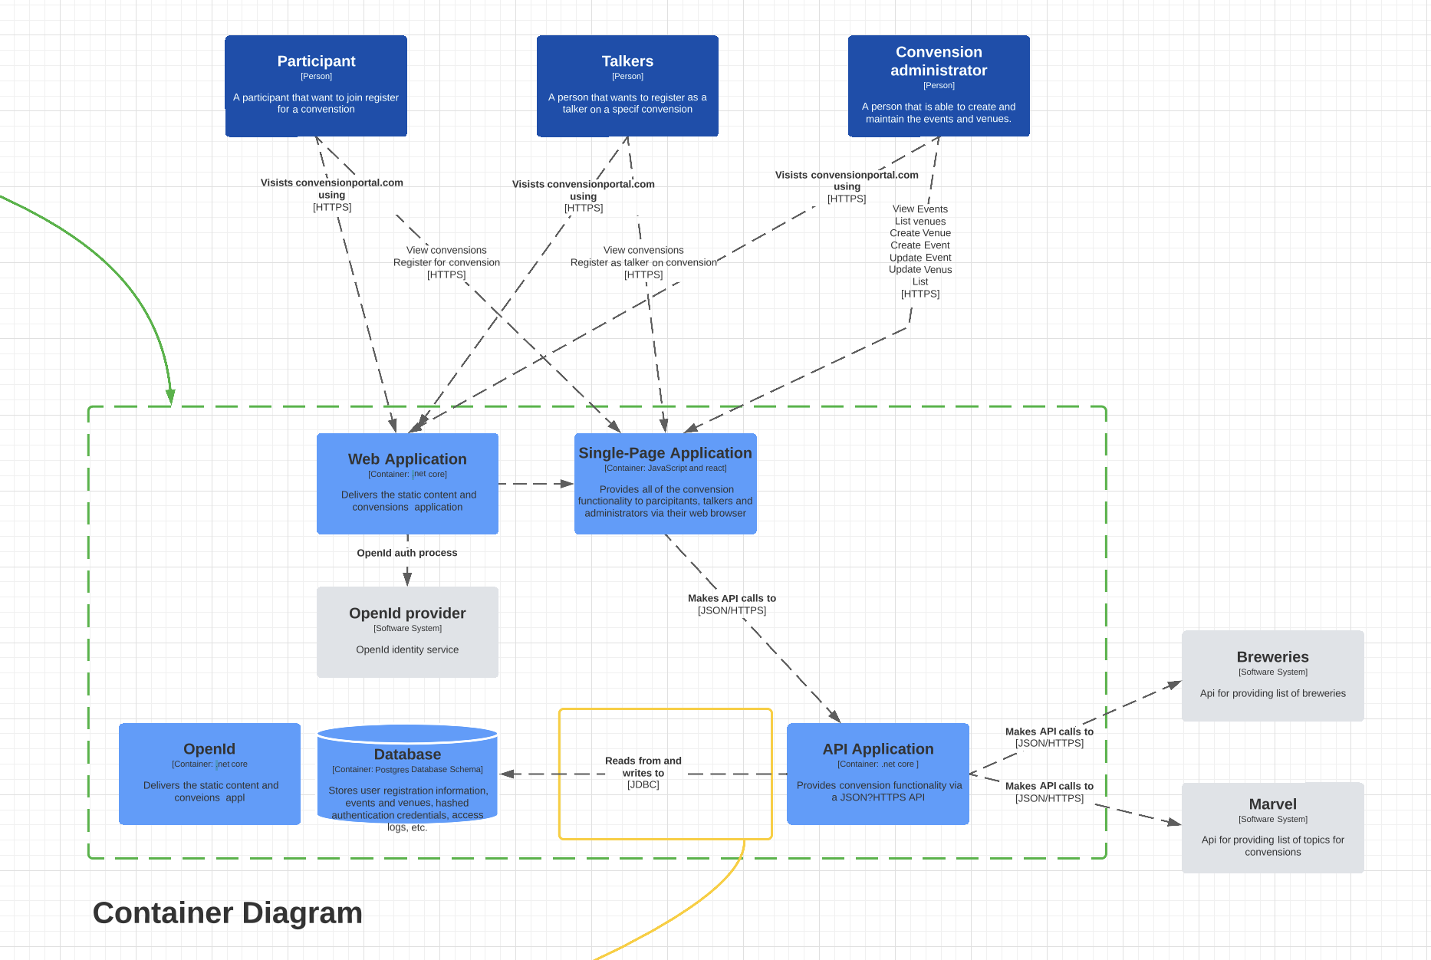
Overview of solution in c4

Slide 7
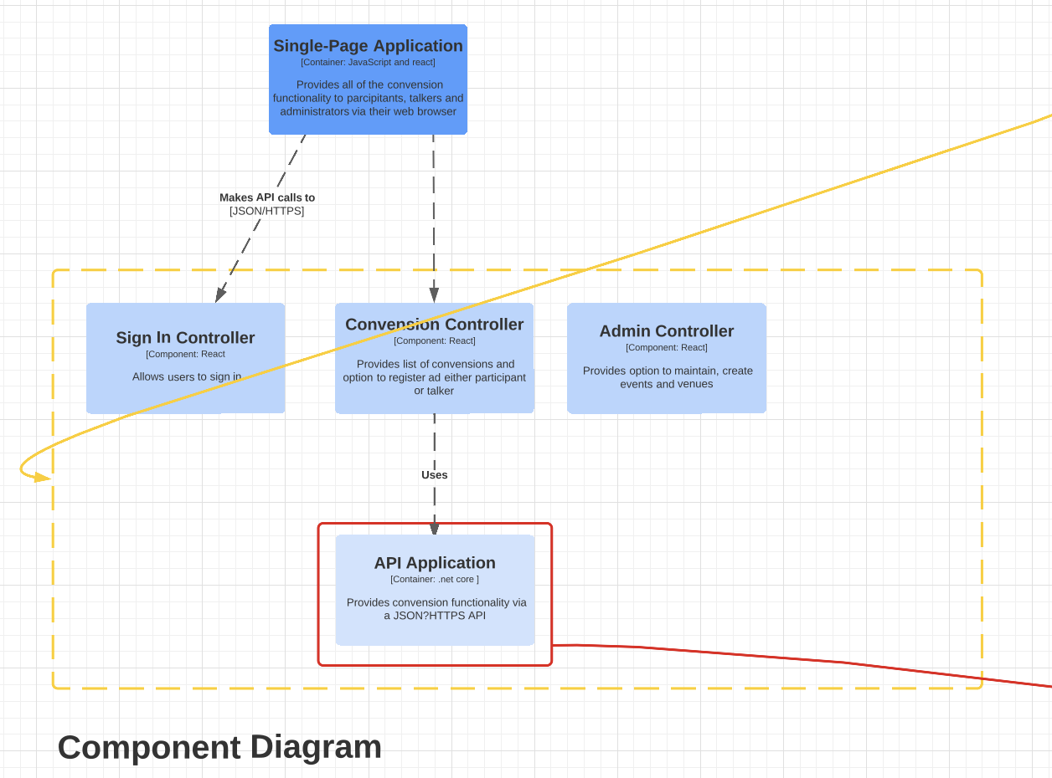
Overview of solution in c4

Slide 8
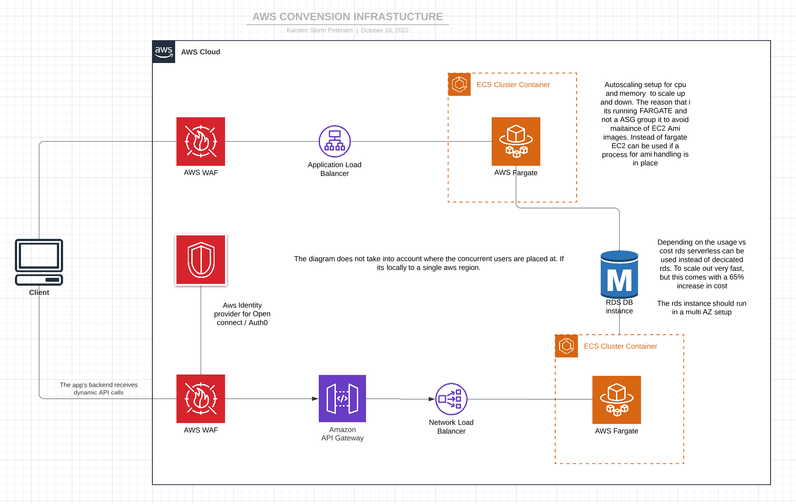
Infrastucture solution

Slide 9
Infrastucture solution
The solution is base consists of four main components
Frontend that implements a Waf, application loadbalancer and ecs service.
Security groups that resticts only traffic of https between WAF, ALB, ecs service and outbound traffic to client and openid provider. If the openid provider is inside
Secutity group that allows ecs service to call RDS
IAM roles that lock down access to only the resources that should be accessed.
Autoscaling on cpu / mem
OpenId provider
AWS identity provider for auth0.

Slide 10
Infrastucture solution
Api that implements a Waf, network loadbalancer and ecs service.
Security groups that resticts only traffic of https between WAF, ALB, ecs service and outbound traffic to client and openid provider. If the openid provider is inside
Secutity group that allows ecs service to call RDS
IAM roles that lock down access to only the resources that should be accessed.
Model on api gateway that does upfront validation of request and openId, so backend services are not being called if user is not validated.
”Usage” of Aws identity provider.
Autoscaling on cpu / mem
RDS in a multi AZ setup.
The RDS has encryption with a KMS key. The kms key can be managed or unmanaged depending on what the
Consider usage of serverless instance type to get faster scaling of capacity (ACU). Serverless should only be used server has time to scale down again and not always is on max.

Slide 11
Rest api solution
The rest api is implementated as a docker on .net core with the following openId scopes talker, participant and administrator. The brewer and topic api call could also be orchestrated in a node.js rest api since the are open but doing this will give a extra latency when calling and extra service. So the tought is that the administrator can import venues and topics from the api to the database.
The rest api solution main focus on the rest api it self with simple set of endpoints, its not a fully designed rest api to support all call from the react frontend.
The Repository are mocked with dummy data end no database is hooked up in the solution.

Slide 12
Questions
?

